Slide 1


BLU
CUSTOMER
SENTIMENT
PREDICTIONS

Slide 2
OBJECTIVE & ACTIONS
data to decisions
algorithm & Beyond
Reshaping the future
01
02
07
05
AGENDA

Slide 3
Challenge:
Low Customer Retention
Objective:
Predict Review Scores utilizing order characteristics
Project Path:
Data –> Models –> Insights -> Solutions & Recommendations
Key Insights:
Product description and shipping cost transparency are top influences in positive review scores
Actions:
Product description and shipping to be optimized for overall customer satisfaction
Impact:
Positive review scores from customers does not significantly increase customer retention
01

Slide 4
DATA INTERPRETATION
ORDERS
Total Orders: 49882
REVIEWS
76% Positive to 23% Negitive Review Scores
Avg length of title & description, total no. of photos, is repeat customer, shipping volumetric & actual weight, price to shipping cost ratio, order payment & type.
REVIEW FACTORS
TITLE LENGTH
Concise name lengths positively impact review scores
DESCRIPTION LENGTH
More detailed descriptions get higher review scores
02

Slide 5
DATA INTERPRETATION
SHIPPING WEIGHTS
Shipments with higher weights received more negitive reviews
PRICE:SHIPPING
Higher Price to Shipping cost ratio did not impact positive reviews
ORDER VALUE
Orders of higher value received more negitive reviews
INSTALLMENTS
One Time Payments of Orders: 23982
Instalment Payments of Orders: 25524
PAYMENT METHODS
Using POS methods (Cr/ Db Cards): 39050
Using contactless methods (Mobile): 10005
VOUCHERS
Customers using vouchers: 1980
Customers not using vouchers: 47902
03

Slide 6
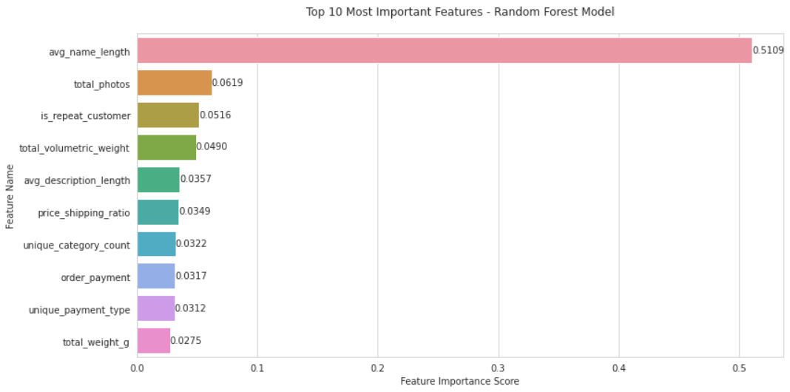
Product Information Excellence (>55% of impact)
Product name optimization (51% importance)
Photo quantity management (6.2% importance)
Description length optimization (3.6% importance)
Operational Efficiency (>8% of impact)
Shipping cost ratio optimization (3.5% importance)
Volumetric weight management (4.9% importance)
04

Slide 7
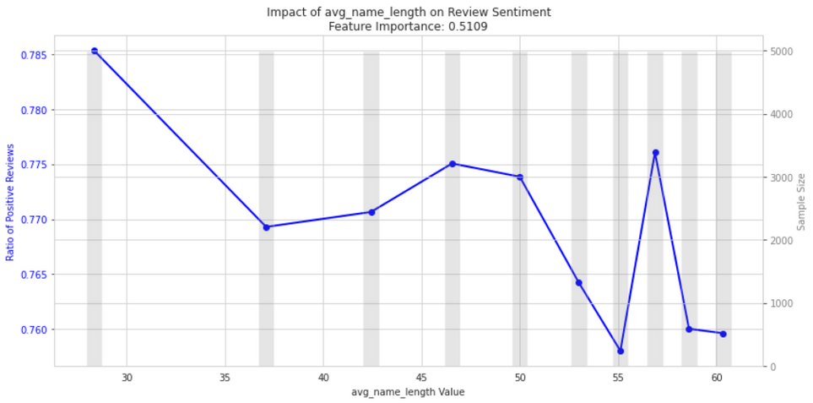
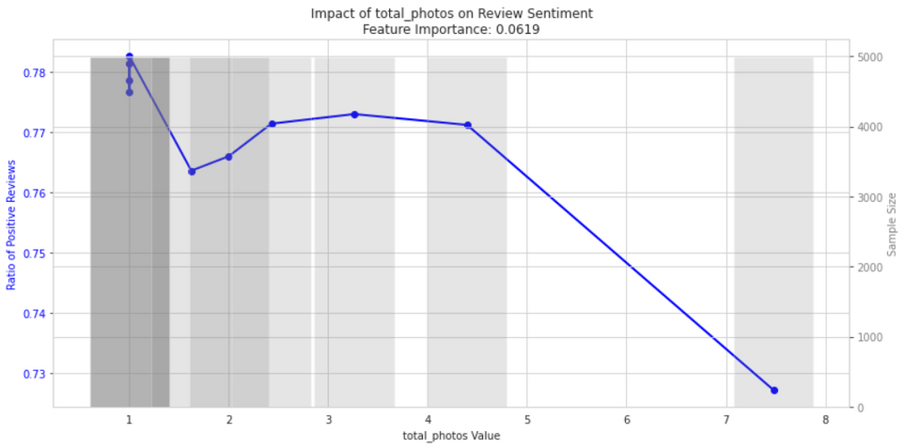
Product Information:
Product naming is the dominant factor with clear & concise lengths appreciated
Short Product descriptions lead to expectation mismatch
Visual content is important, item listings should at least have one photo but optimized to not have too many
05

Slide 8
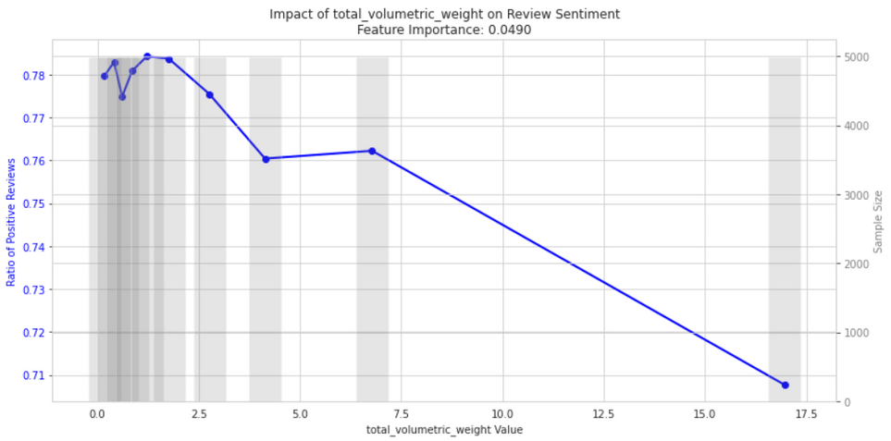
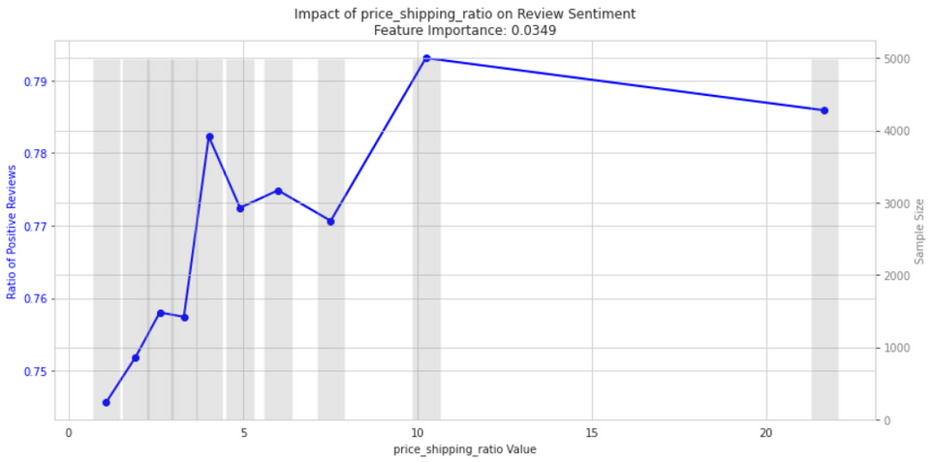
Operations:
Shipping and Logistic is the second most dominant factor in positive review scores by customers
Volumetric weight optimization is essential. Higher the volumetric weight, higher the shipping cost leading to customer dissatisfaction
Item Price to shipping cost ratio reveals that products with higher prices are positioned to have more satisfactory shipping costs than items with lower price.
06

Slide 9
METHODOLOGY
Objective Definition
Iterative Development
Clearly defined the problem and identified a classification model as the most suitable approach
Explored and tested different algorithms, parameter configurations to optimize performance
Evaluation
Data-Driven Decision Making
Assessed model effectiveness using key metrics such as accuracy, precision, F1- score
Transformed model statistics to visual insights through charts and tables for interpretation
07

Slide 10
DATA PREPARATION
FEATURE ENGINEERING
MODEL SELECTION
INTERPRETING THE MODEL
TRANSFORMING INTO INSIGHTS
THE MODEL PIPELINE
08

Slide 11
FEATURE ENGINEERING
avg_name_length = len(product_name)
avg_description_length = len(product_description)
total_photos = sum(product_photos_qty)
total_volumetric_weight = (length * width * height) / 5000
price_shipping_ratio = shipping_cost / order_value
Delivery_Date_Deviation = order_estimated_delivery_date - order_delivered_customer_date
days_since_first_order = order_purchase_timestamp - first_order_date ( of the customer)
and more with total no. of features: 261
TRAINING: (70%)
VALIDATION:
(15%)
TEST:
(15%)
35150
POSITIVE REVIEWS (4-5)
38370
7448
NEGATIVE REVIEWS (1-3)
11512
7284
09

Slide 12
MODEL SELECTION
Random Forest was selected as the optimum model for its robustness, resistance to over-fitting, and ability to handle high-dimensional data. It provides feature importance insights for better model interpretability by aggregating multiple decision trees.
AUC-ROC
PRECISION
F1 - Score
TPR
0.7361
0.8379
0.8762
0.9228
Accuracy
Recall
Specificity
FPR
0.8005
0.9183
0.4078
0.5922
Best Parameters
Number of Trees (150) , Max Depth (15) , Min Instances Per Node (10)
10

Slide 13
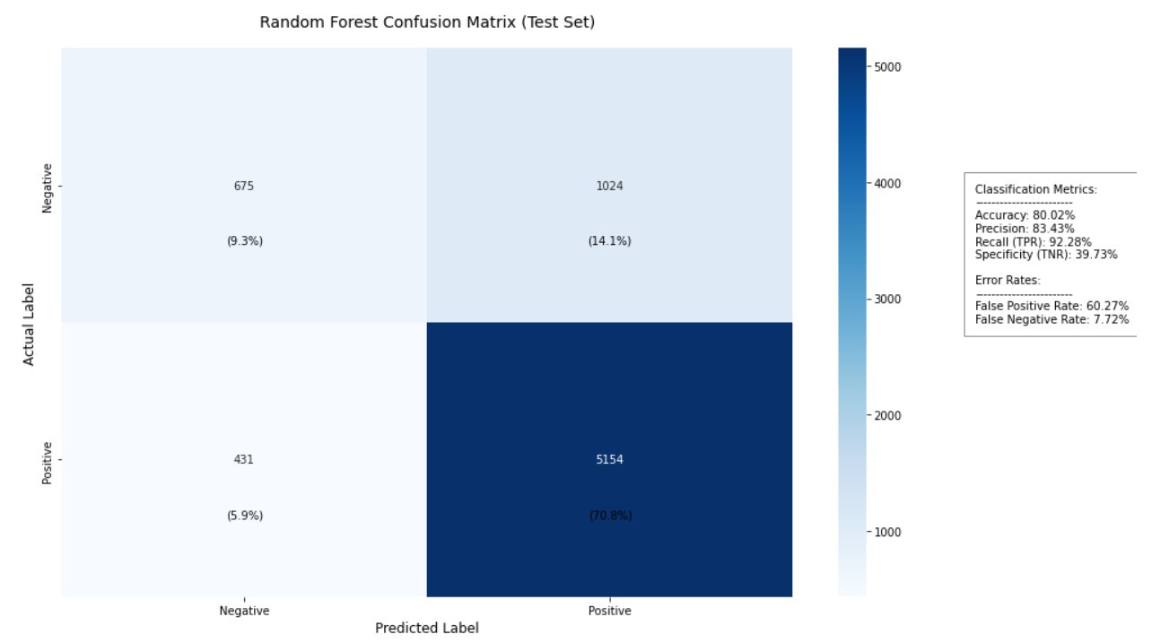
CONFUSION MATRIX
The model achieved 80.02% accuracy with a high recall (92.28%), it efficiently identifies most positive cases. However, the False Positive Rate (60.27%) suggests that the model frequently misclassified negative instances as positive. This behavior could be influenced by noisy data, class imbalance or overlapping features, making it harder to distinguish between classes.
10

Slide 14
THANK YOU
Presented by
ZHANG TAO
NEMANI GAURAV

